Slide 1
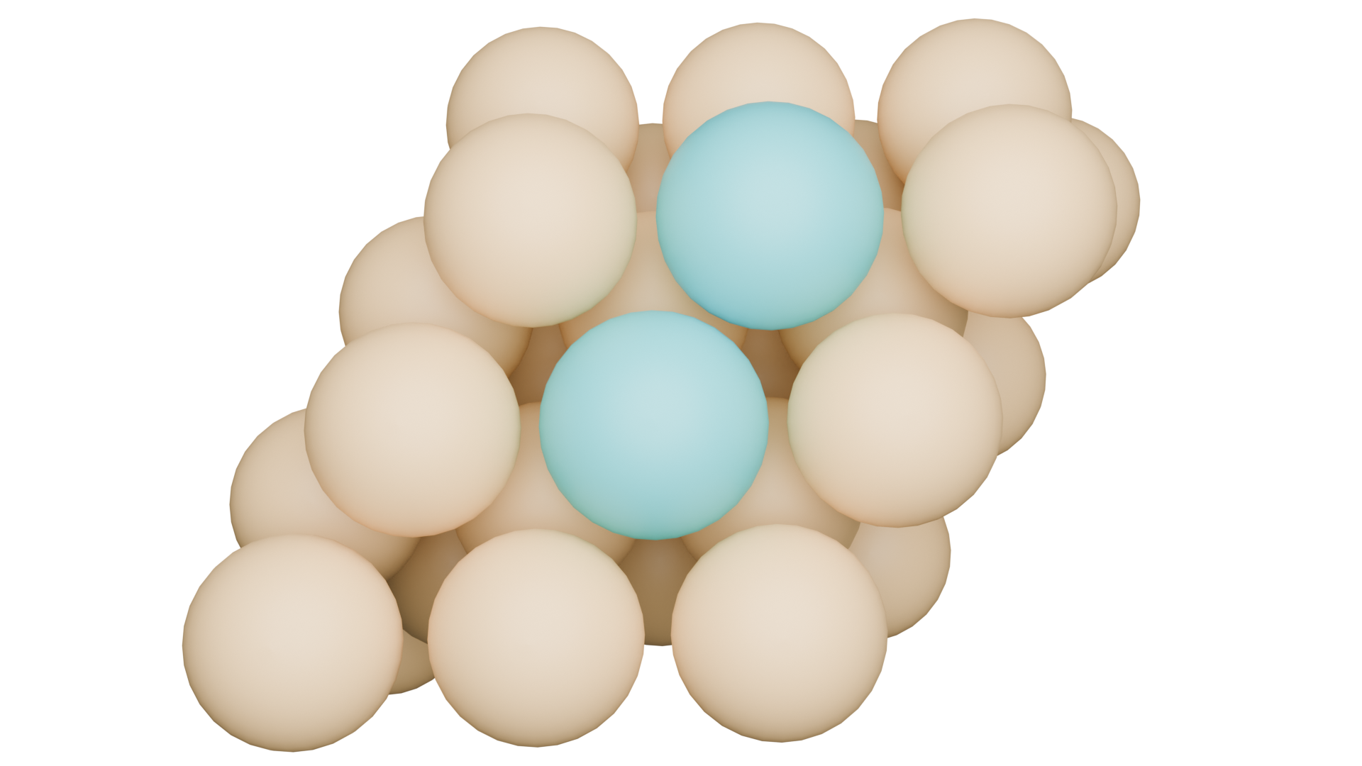
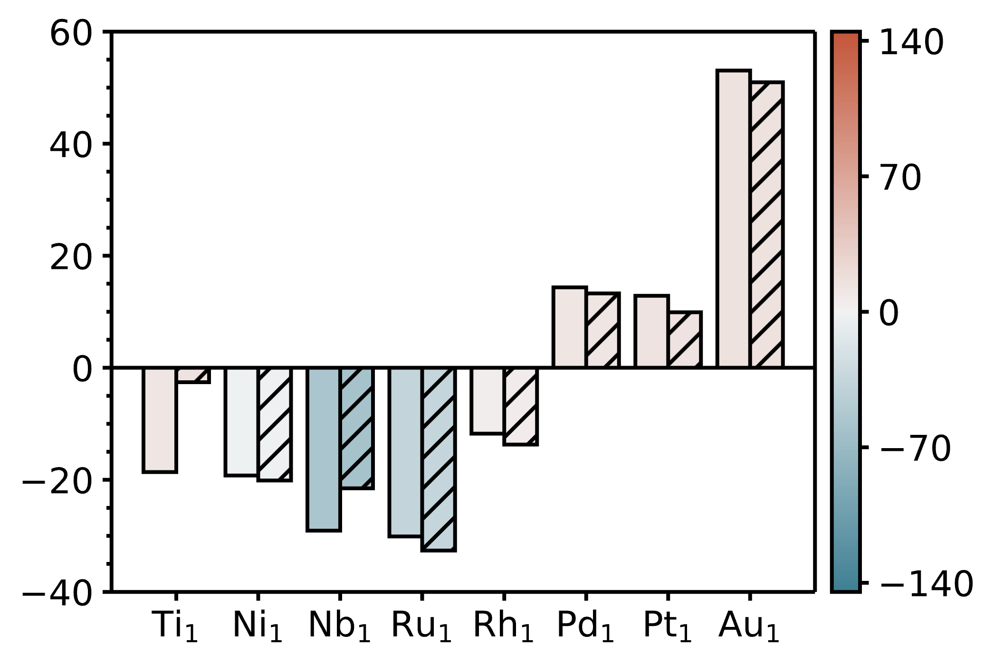
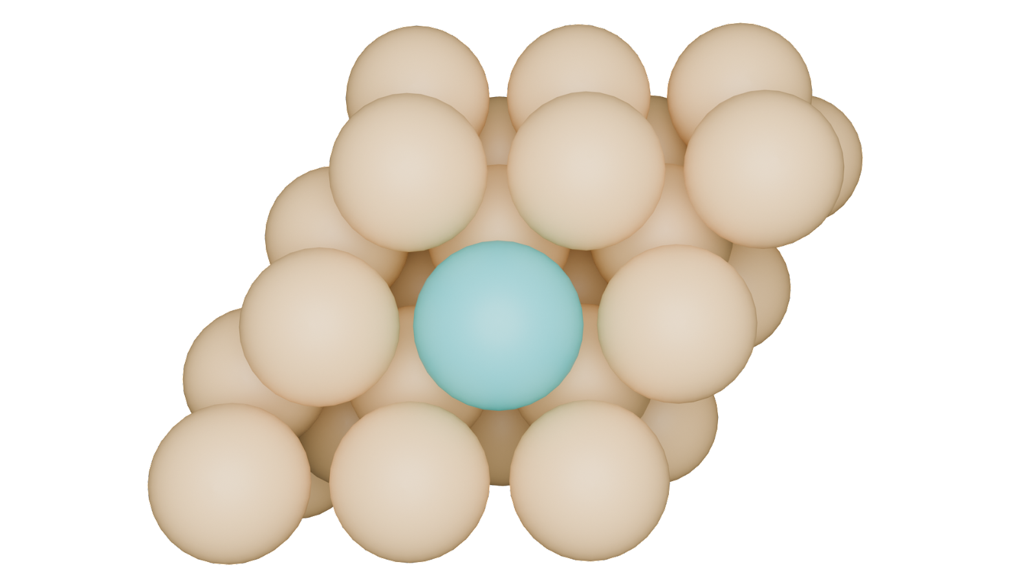
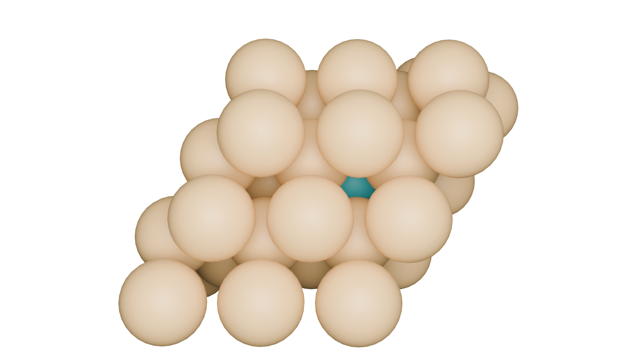
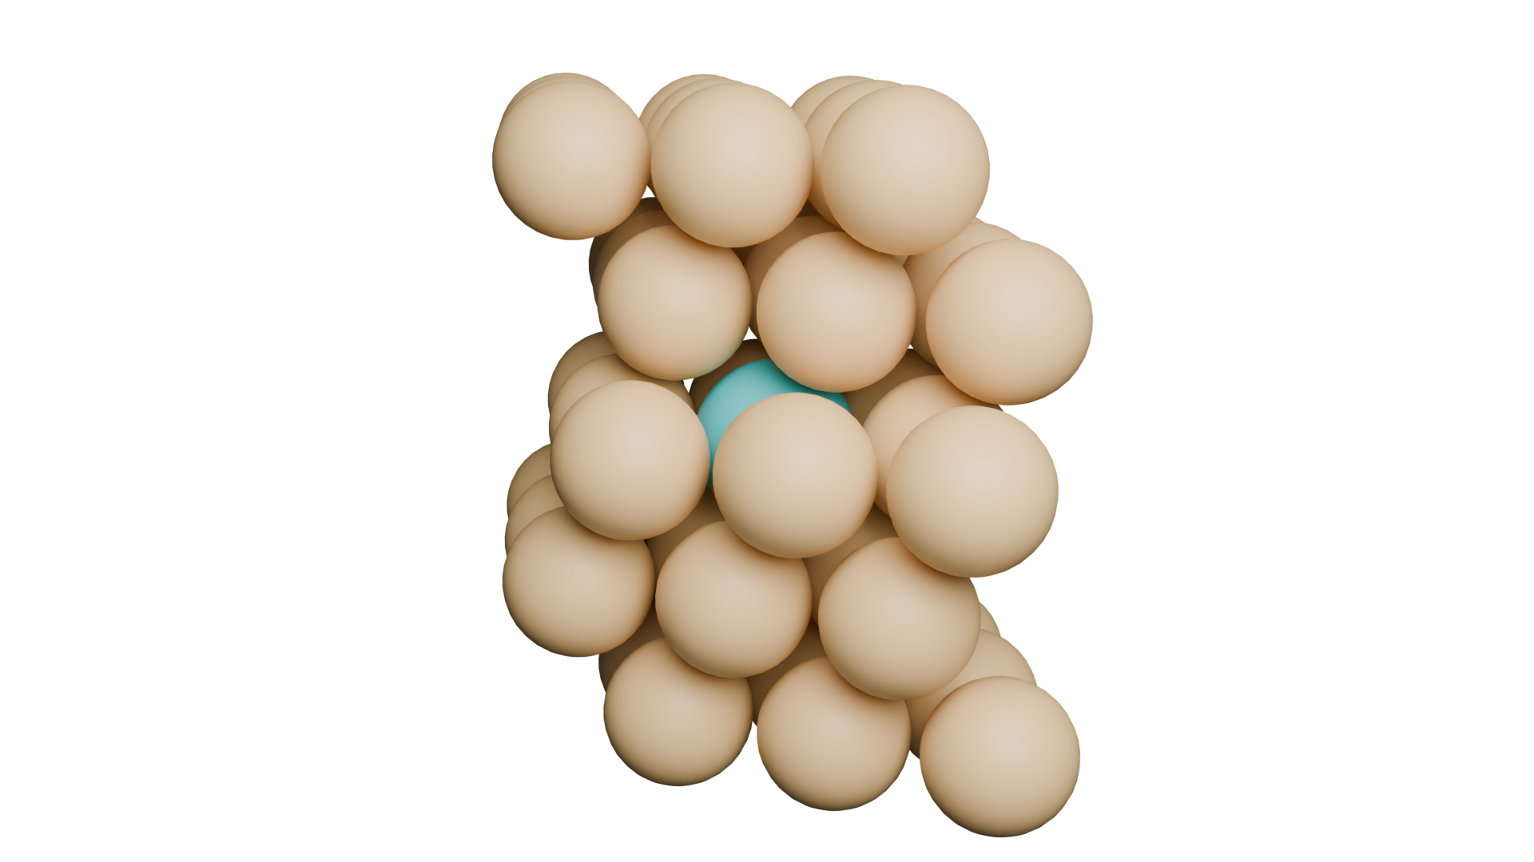
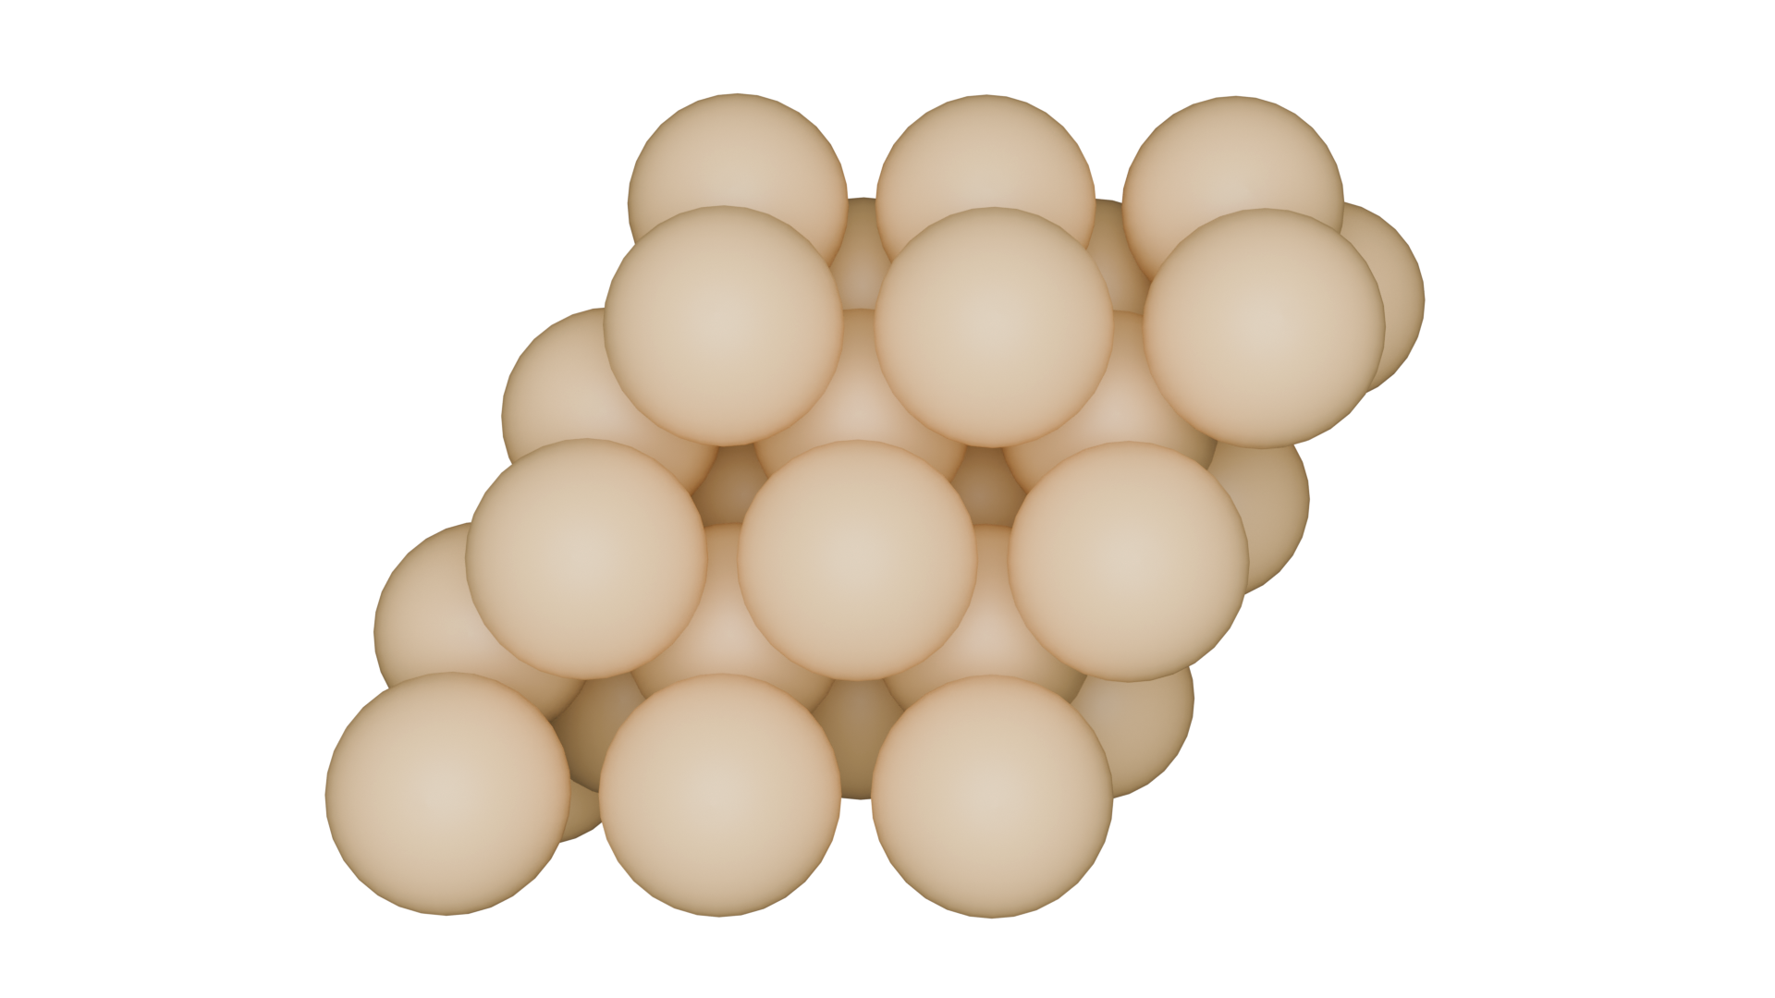

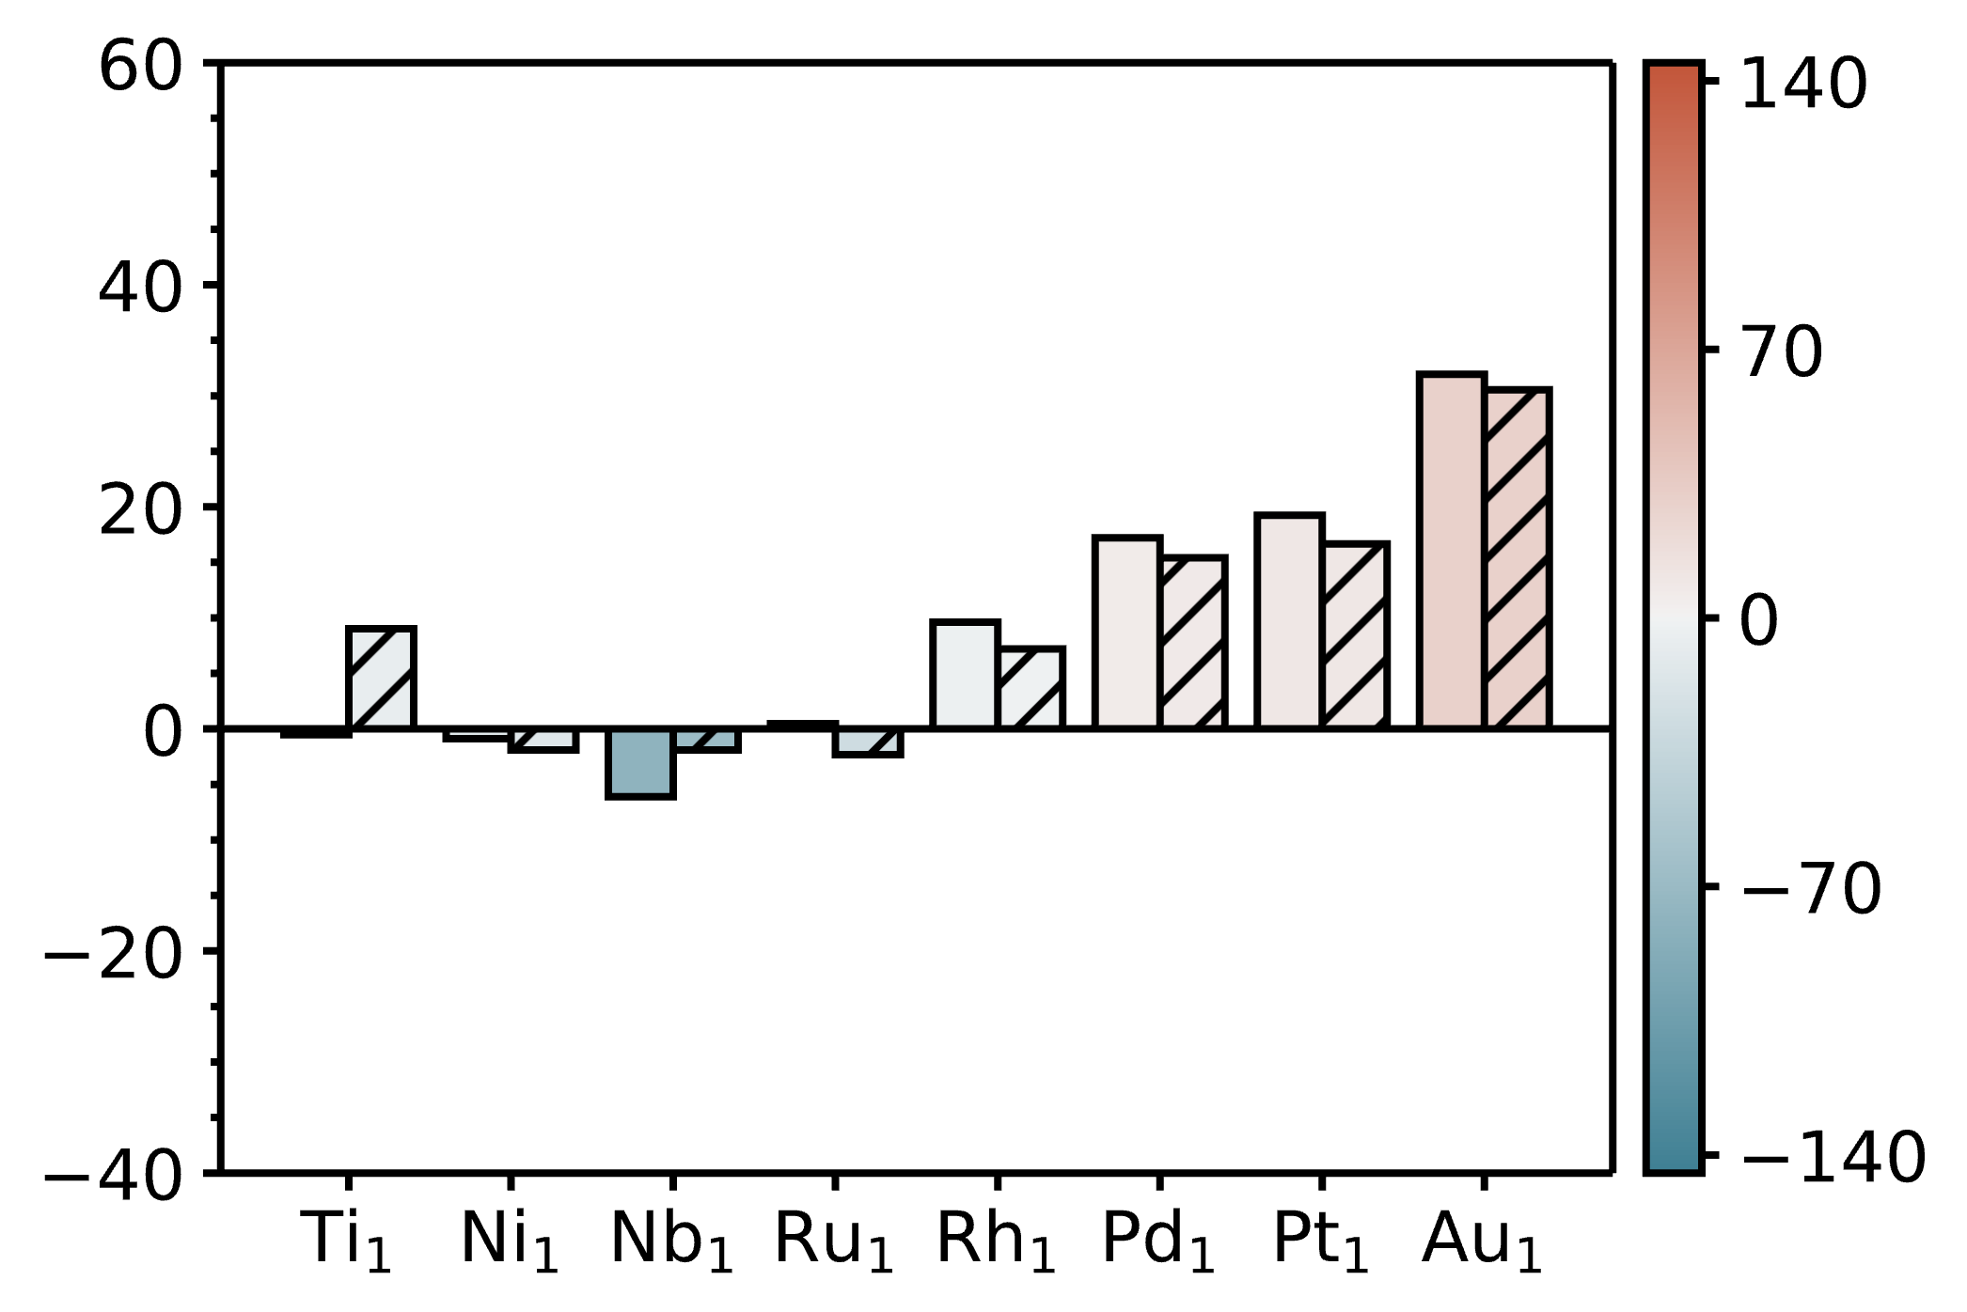
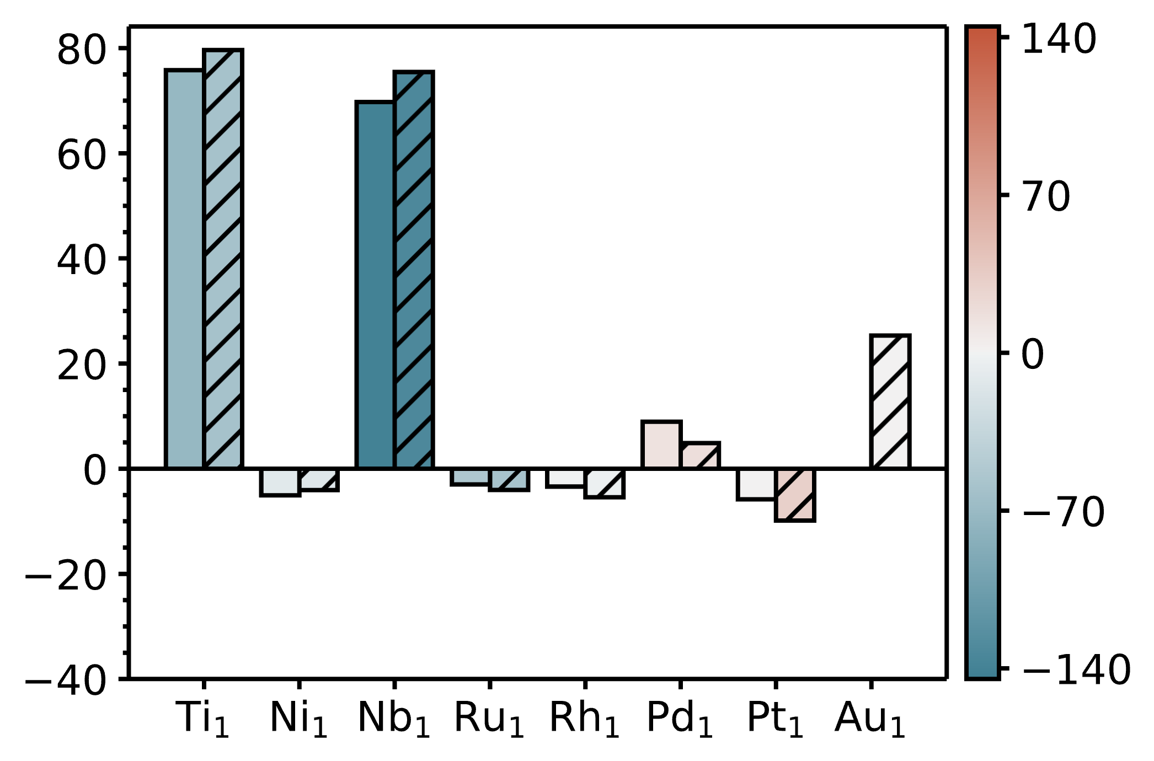
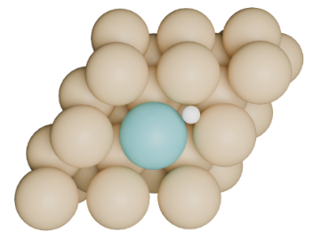
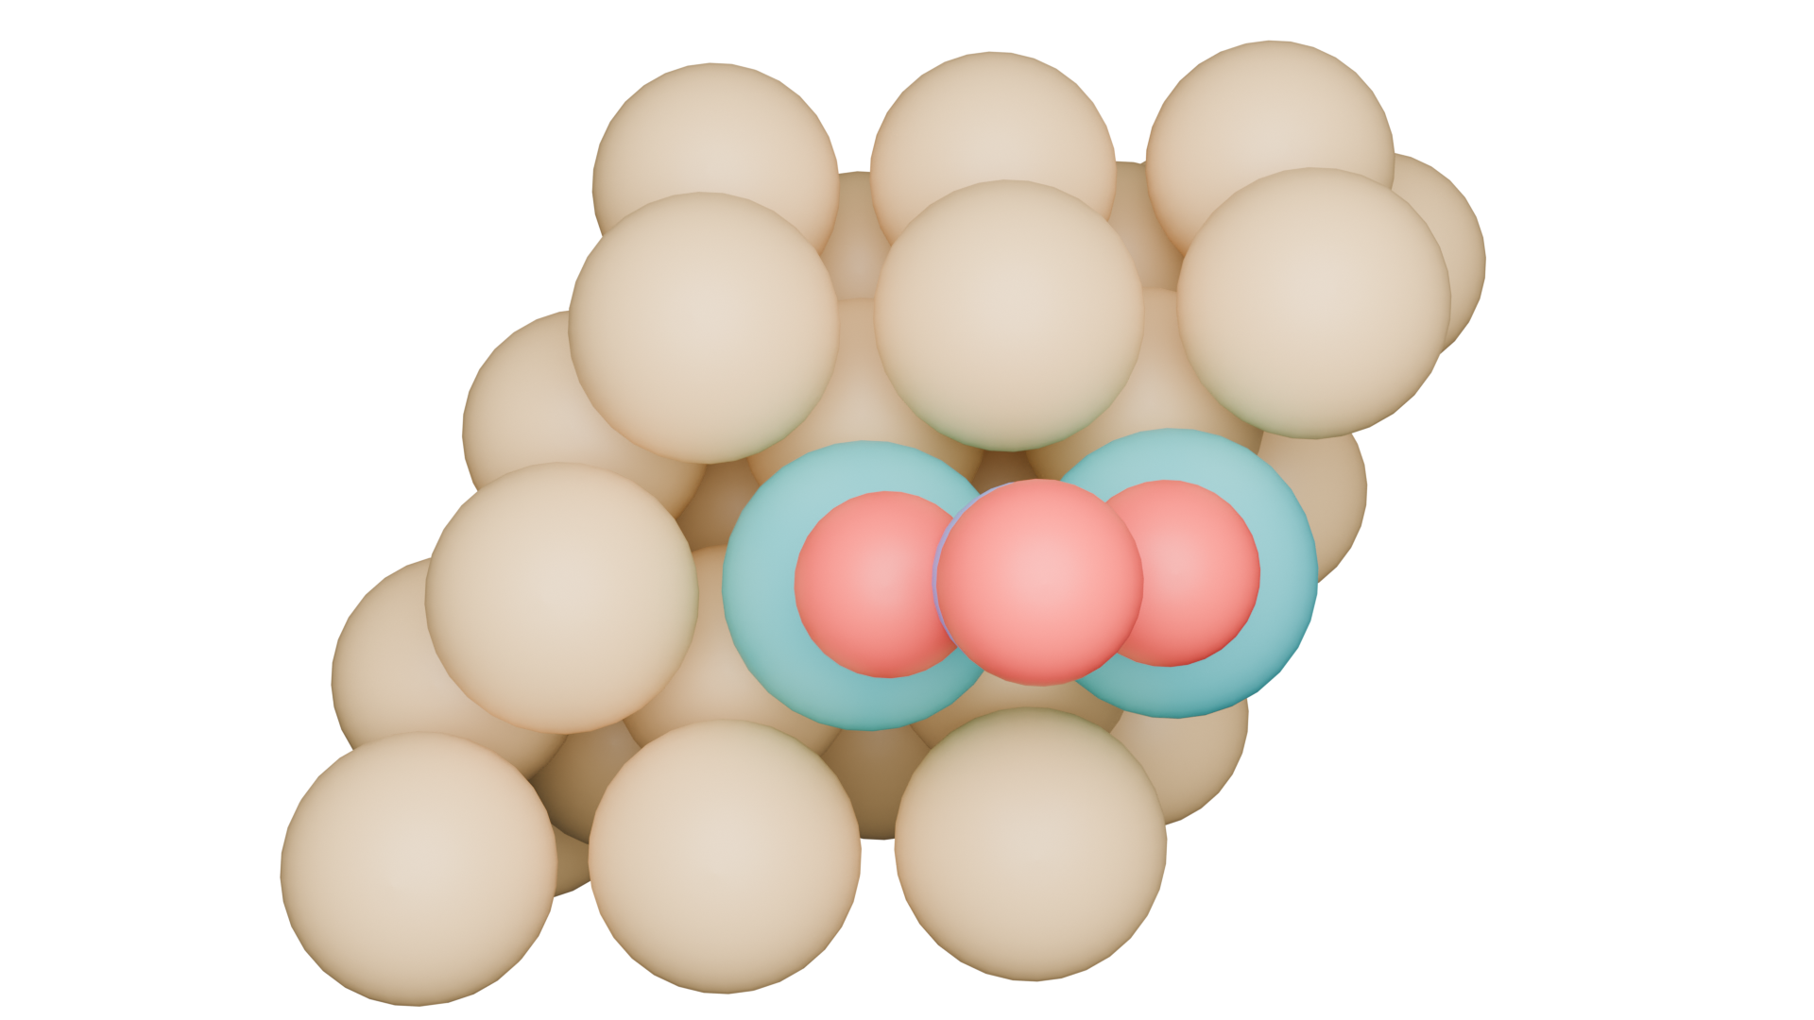
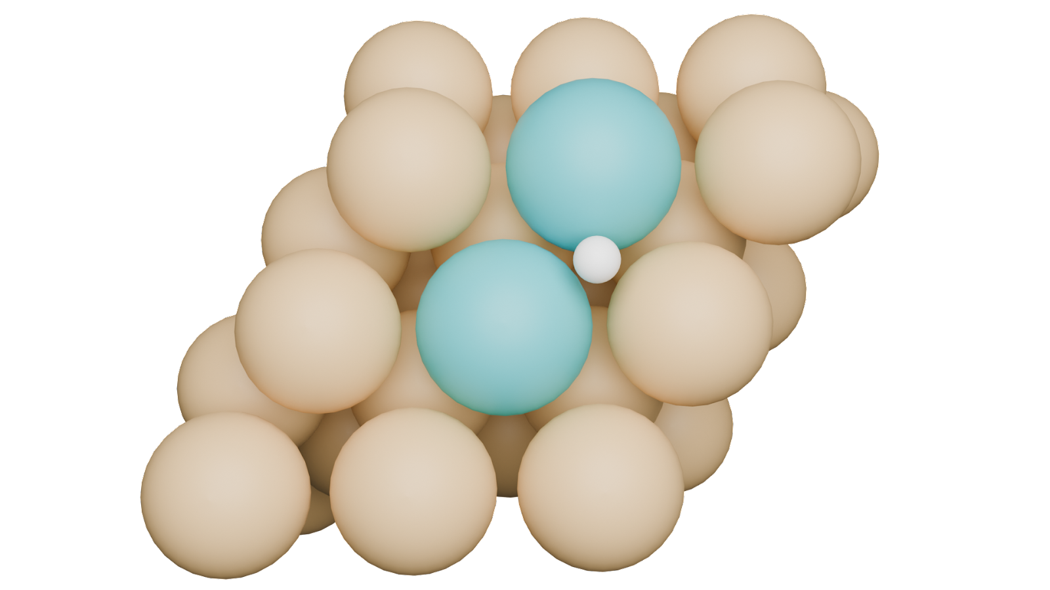
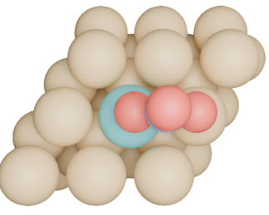
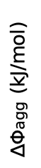
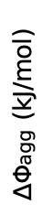
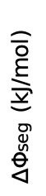
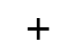
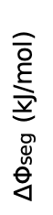
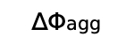
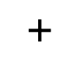
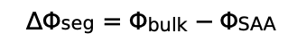
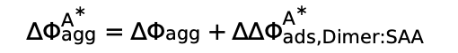
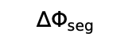
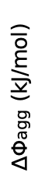
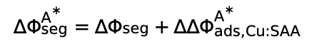
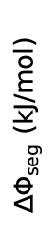
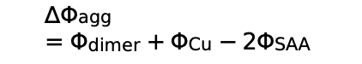
(a)
(b)
$∆Φ_{seg}=Φ_{bulk}−Φ_{SAA}$
Bare
Top view
Side view
Dopant
$$∆Φ_{seg}$$
Host
$∆Φ_{agg}$ (kJ/mol)
$∆Φ_{seg}$ (kJ/mol)
$$∆Φ_{agg}=Φ_{dimer}+Φ_{Cu}−{2Φ}_{SAA}$$
$$+$$
$$∆Φ_{agg}$$
$$+$$
$$∆Φ_{seg}^{A^{∗}}={∆Φ_{seg}+∆∆Φ}_{ads, Cu:SAA}^{A^{∗}}$$
Adsorbate
effects
$$∆Φ_{agg}^{A^{∗}}=∆Φ_{agg}+{∆∆Φ}_{ads, Dimer:SAA}^{A^{∗}}$$
(c)
A* = H*
(d)
A* = NO₃*
$∆Φ_{seg}$ (kJ/mol)
$∆Φ_{agg}$ (kJ/mol)
$∆Φ_{agg}$ (kJ/mol)
$∆Φ_{seg}$ (kJ/mol)

